Slide 1

Methods for Causal Inference in Educational Research
January/February 2022
Isa Steinmann

Slide 2
9 | Regression Discontinuity Designs II Time: 14 February 2022, 12:15-14:00h Main instructor: Isa Steinmann Required reading: Luyten (2006)
10 | Differences-in-Differences Designs I Time: 17 February 2022, 12:15-14:00h Main instructor: Isa Steinmann Required reading: Angrist & Pischke (2015), chapter 5
11 | Differences-in-Differences Designs II Time: 21 February 2022, 12:15-14:00h Main instructor: Isa Steinmann Required reading: Strello, Strietholt, Steinmann, & Siepmann (2021)
12 | Lessons Learned and Closing Time: 23 February 2022, 12:15-14:00h Main instructor: Isa Steinmann Required reading: Rutkowski & Delandshere (2016)
9 | Regression Discontinuity Designs II Time: 14 February 2022, 12:15-14:00h Main instructor: Isa Steinmann Required reading: Luyten (2006)
10 | Differences-in-Differences Designs I Time: 17 February 2022, 12:15-14:00h Main instructor: Isa Steinmann Required reading: Angrist & Pischke (2015), chapter 5
11 | Differences-in-Differences Designs II Time: 21 February 2022, 12:15-14:00h Main instructor: Isa Steinmann Required reading: Strello, Strietholt, Steinmann, & Siepmann (2021)
12 | Lessons Learned and Closing Time: 23 February 2022, 12:15-14:00h Main instructor: Isa Steinmann Required reading: Rutkowski & Delandshere (2016)
9 | Regression Discontinuity Designs II Time: 14 February 2022, 12:15-14:00h Main instructor: Isa Steinmann Required reading: Luyten (2006)
10 | Differences-in-Differences Designs I Time: 17 February 2022, 12:15-14:00h Main instructor: Isa Steinmann Required reading: Angrist & Pischke (2015), chapter 5
11 | Differences-in-Differences Designs II Time: 21 February 2022, 12:15-14:00h Main instructor: Isa Steinmann Required reading: Strello, Strietholt, Steinmann, & Siepmann (2021)
12 | Lessons Learned and Closing Time: 23 February 2022, 12:15-14:00h Main instructor: Isa Steinmann Required reading: Rutkowski & Delandshere (2016)

Slide 3
Take-away messages
!
RDD takes advantage of more or less arbitrary cutoffs in running variables to, under the assumption that near the cutoff individuals’ average characteristics are equal, infer causal effects of treatment
Sharp RDDs allow causal inference when treatment switches at the cutoff
Fuzzy RDDs allow causal inference when treatment probability or intensity changes at the cutoff
Fuzzy RDDs are methodologically equivalent to IV

Slide 4
Overview
Example of Luyten (2006)
Example of Steinmann & Olsen (under review)
R demonstration
Requirements for RDD designs

Slide 5
?
What do you remember from Luyten (2006)?

Slide 6
The effect of schooling
In Coleman Report, isolation of within- and between-school variation in student achievement → interpretation of low between-school variation as indication that schooling had a small effect on achievement
This relative school effect could, however, also reflect a high-quality instruction in all schools and a low variation in student compositions
→ What is the absolute effect of schooling?
Luyten (2006)

Slide 7
?
How could one measure absolute school effect in hypothetical randomized controlled trial?

Slide 8
RDD design
Achievement
Lower grade
Upper grade
Age in months

Slide 9
RDD design
Mean difference reflects both age and schooling differences
Achievement
Lower grade
Upper grade
Age in months

Slide 10
RDD design
Added-year effect
Achievement
Age effect
Lower grade
Upper grade
Age in months
Luyten (2006)

Slide 11
RDD design
?
Added-year effect
Achievement
Age effect
In Norway, cut-off value is 01 January. Where are December- and January-born children?
Lower grade
Upper grade
Age in months

Slide 12
RDD design
Youngest in upper grade
(December-born)
Oldest in lower grade
(January-born)
?
Added-year effect
Achievement
Age effect
In Norway, cut-off value is 01 January. Where are December- and January-born children?
Lower grade
Upper grade
Age in months

Slide 13
RDD design
A
B
C
Differences in added-year effects
Achievement
Differences in student selection
Lower grade
Upper grade
Age in months
Luyten (2006)

Slide 14
TIMSS 1995 samples in Luyten (2006)
Rule of thumb: share of compliers must be >95% to apply sharp RDD
Share of compliers
Share of non-compliers

Slide 15
Descriptives in Luyten (2006)
→ Mean differences reflect both age and added-year effects

Slide 16
Findings in Luyten (2006)
→ Both age and added-year effects

Slide 17
Findings in Luyten (2006)
Between-country variation in size and proportion of
age and added-year effects

Slide 18
Findings in Luyten (2006)
Low between-school variation in added-year effects
in some countries; larger in others

Slide 19
?
Questions so far?

Slide 20
Aim in Steinmann & Olsen (under review)
Disentangling the between-school variation in school effectiveness (added-year slopes) from the between-school variation in student selection (intercepts) using two-level regression discontinuity design
Replication across 13 samples of Nordic and European countries

Slide 21
Data in Steinmann & Olsen (under review)
Countries that participated with two adjacent school grades in TIMSS and had high complier rates (at least 93% of students in formally correct grades)
In analysis samples, we only included schools with at least 10 students in the lower and 10 students in the upper grades
Primary school level:
Norway 2015
Norway 1995
Iceland 1995
Cyprus 1995
Greece 1995
Scotland 1995
Secondary school level:
Norway 2015
Norway 1995
Iceland 1995
Sweden 1995
Cyprus 1995
Scotland 1995
Slovak Rep. 1995

Slide 22
Samples in Steinmann & Olsen (under review)
→ Simple exclusion of non-compliers

Slide 23
Samples in Steinmann & Olsen (under review)
→ Exclusion of small schools

Slide 24
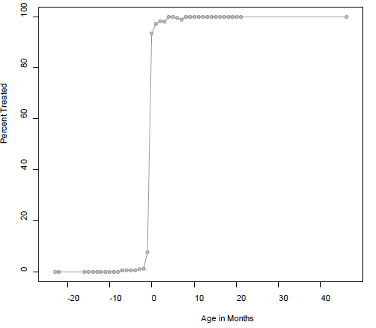
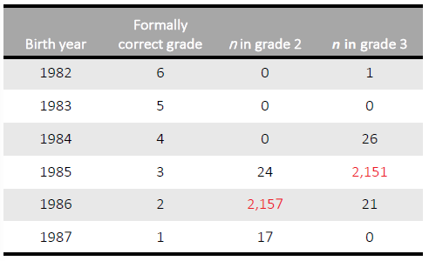
Excursus: Simple exclusion of non-compliers in Steinmann & Olsen (under review)
Discontinuity is not deterministic/sharp around the cutoff
Especially around the cutoff, some younger students already in higher and some older students still in lower grade

Slide 25
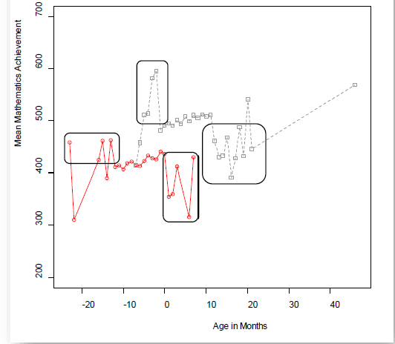
Excursus: Simple exclusion of non-compliers in Steinmann & Olsen (under review)
Discontinuity is not deterministic/sharp around the cutoff
Especially around the cutoff, some younger students already in higher and some older students still in lower grade
These differ systematically from others and would bias the estimation of age and added-year effects
Replication with fuzzy RDD (or IV) approach using 2SLS results in qualitatively similar findings

Slide 26
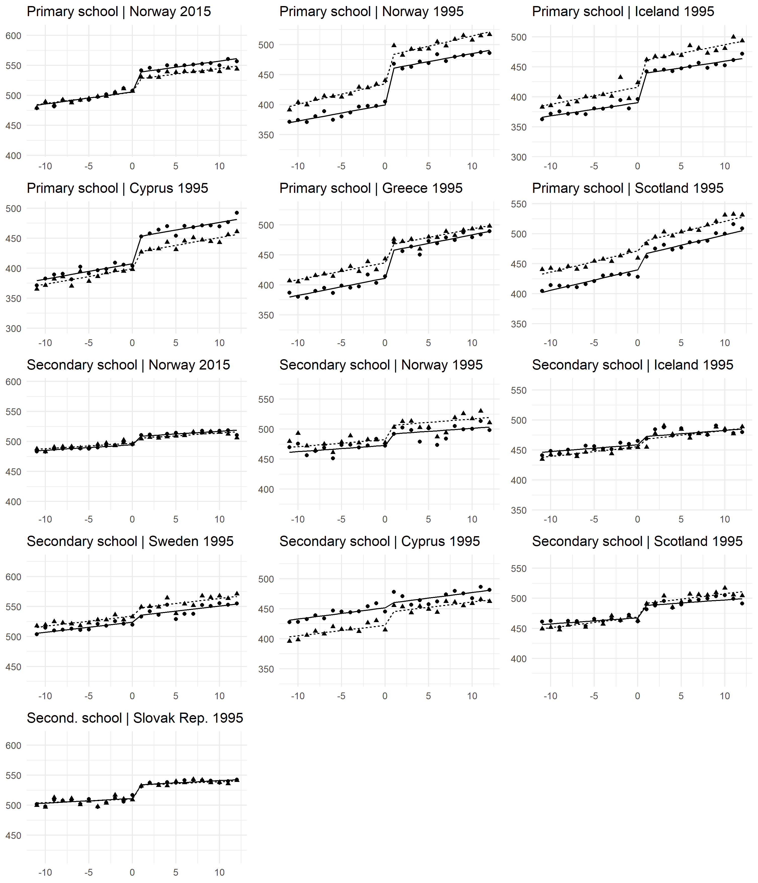
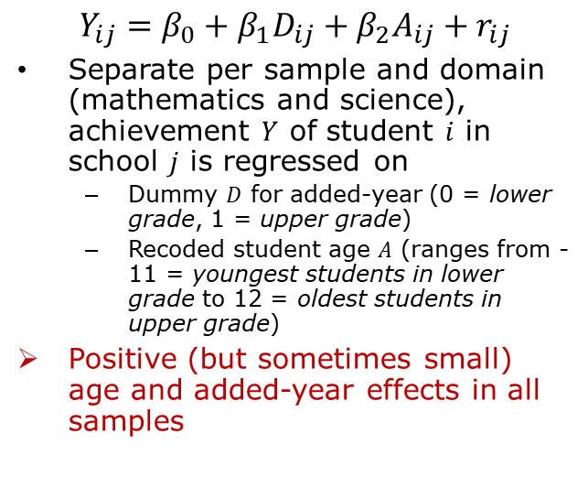
Student-level findings in Steinmann & Olsen (under review)
$Y_{ij}=β_{0}+β_{1}D_{ij}+β_{2}A_{ij}+r_{ij}$
Separate per sample and domain (mathematics and science), achievement $Y$ of student $i$ in school $j$ is regressed on
Dummy $D$ for added-year (0 = lower grade, 1 = upper grade)
Recoded student age $A$ (ranges from -11 = youngest students in lower grade to 12 = oldest students in upper grade)
Positive (but sometimes small) age and added-year effects in all samples

Slide 27
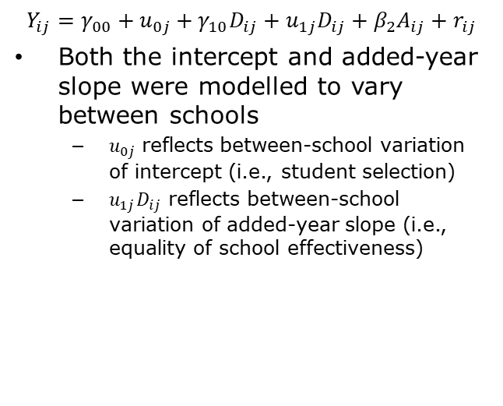
School-level findings in Steinmann & Olsen (under review)
A
B
C
$$Y_{ij}=γ_{00}+u_{0j}+γ_{10}D_{ij}+u_{1j}D_{ij}+β_{2}A_{ij}+r_{ij}$$
Both the intercept and added-year slope were modelled to vary between schools
$u_{0j}$ reflects between-school variation of intercept (i.e., student selection)
$u_{1j}D_{ij}$ reflects between-school variation of added-year slope (i.e., equality of school effectiveness)
Differences in added-year effects
Achievement
Differences in student selection
Stable age effects
Lower grade
Upper grade
Age in months
How large is between-school variation in intercepts and added-year slopes?

Slide 28
School-level findings in Steinmann & Olsen (under review)
A
B
C
Intercept varies between schools
Less variation in Norway, Iceland, Sweden, and Cyprus as compared to Scotland, Greece, and the Slovak Republic
Added-year effects range:
Between 0.31‒0.63 SD (mathematics) and 0.20‒0.45 SD (science) at primary school level
Between 0.09‒0.33 SD (mathematics) and 0.08‒0.31 SD (science) at secondary school level
Equality of school effectiveness
Less between-school variation in added-year slopes in Norway, Iceland, and Cyprus
More pronounced in Sweden, Scotland, and Slovak Republic
Differences in added-year effects
Achievement
Differences in student selection
Stable age effects
Lower grade
Upper grade
Age in months
How large is between-school variation in intercepts and added-year slopes?

Slide 29
Discussion in Steinmann & Olsen (under review)
Implications
Although schools differ in student selection (i.e., intercepts), countries can attain high degree of equality of school effectiveness (i.e., low between-school variation of added-year effects)
Although schools with a privileged socioeconomic composition usually have higher intercepts, they do not always have higher added-year effects
Contributions
Study demonstrates how the equality of school effectiveness measure can be compared
Between countries (Norway, Iceland, Sweden, Cyprus, Greece, Scotland, Slovak Republic)
Over a 20-year interval (Norway 1995‒2015)
Between primary and secondary school levels
Complementation of previous literature
Norway 2015 data
Less complex and better interpretable model

Slide 30
Discussion in Steinmann & Olsen (under review)
Conclusion
Two-level regression discontinuity design can be applied if
Two adjacent grades at same schools
Large samples
High proportions of students in formally correct grades
Major advantages in comparison with longitudinal designs
Cross-sectional data collection less time-consuming and expensive
Minimal attrition issues
Can be implemented in international and trend designs
Recommendation to extend the international designs in the Nordic countries

Slide 31
?
Questions so far?

Slide 32
R demonstration
…
See
CausalInference_Session9_Material1.R
TIMSS1995NORpopA.RData

Slide 33
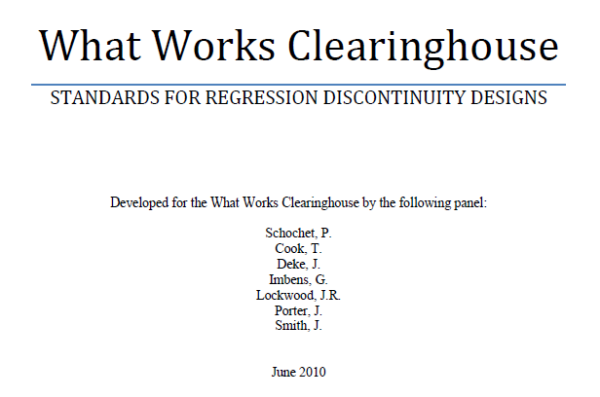
Requirements for RDD designs

Slide 34
Meeting requirements in Steinmann & Olsen (under review)
1
The running variable, in this case the age in months, should have at least four unique values below and above the threshold and should not be confounded with other interventions.
In the present study, the running variable age had 12 unique values in both the lower and upper grades. It seems furthermore unlikely that age might be confounded with additional interventions since students of different age have, within the grades, the same curricula and teachers.

Slide 35
Meeting requirements in Steinmann & Olsen (under review)
2
It should be ensured that the running variable, in this case age, is not systematically manipulated to change the treatment assignment, i.e., the school entry.
Manipulating both the birth date of a child and the scoring rule, i.e. the school entry regulations, is unlikely. The school entry rules are determined by policy-makers and rarely changed. The frequency of months of age did not change systematically around the threshold, which could otherwise be interpreted as an indication for systematic manipulations of birth dates by parents. Furthermore, the frequency of non-compliers was below 8% in all 13 samples

Slide 36
Meeting requirements in Steinmann & Olsen (under review)
3
Researchers should also assure that the attrition by treatment status, running variable, and outcome are low so that the generalizability of the findings and absence of systematic biases and can be assumed.
In the present study, there was no attrition by treatment status, since all students were either in the lower or upper grades. The attrition by the running variable age was, with one exception, negligible (≤ 2%). There was also no attrition by the outcomes since the achievement plausible values were available for all students. The findings are however only generalizable to populations who participated in the TIMSS tests and who were not excluded otherwise.

Slide 37
Meeting requirements in Steinmann & Olsen (under review)
4
It should furthermore be established that if the treatment would not take place, there would be a smooth relationship between the running variable and the outcome at the threshold.
In this study, this means that if the younger and older students entered school at the same time and attended the same grade, we should not observe a discontinuity in the achievement regression. This might not be the case if the student selection mechanisms would differ between the two grades, for instance. We approximated this by showing that correlates of achievement, namely gender and the number of books at home, did not systematically change at the threshold. Furthermore, we observed no other achievement discontinuities within the grades.

Slide 38
Meeting requirements in Steinmann & Olsen (under review)
5
Lastly, it should be assured that the assumption of the functional form holds empirically and that the effects do not change drastically when investigating subsets of cases closer to the threshold.
Our model assumed the same linear effects of age in both grades after controlling for the added-year effect. We ran an alternative model with an additional quadratic term for age, one with an additional interaction term between age and grade, and one with a reduced sample of students in the bandwidth of 6 months before and 6 months after the threshold. With one exception each, the regression parameters of the additional quadratic or interaction terms were not statistically different from zero across samples and domains. When only analyzing the subset of students that were closest to the threshold, both age and grade effects were either statistically significant and positive or not significantly different from zero.

Slide 39
?
Questions?

Slide 40
Take-away messages
!
RDD can be applied to isolate the effects of age and schooling on scholastic outcomes
Decision to apply sharp instead of fuzzy RDD must be well-justified if there are non-compliers
When applying RDD, one must check if RDD requirements are met (e.g., What Works Clearinghouse)
Regression discontinuity “doesn’t work for all causal questions, but it works for many. And when it does, the results have almost the same causal force as those from a randomized trial” (Angrist & Pischke, 2015, p. 147)

Slide 41
9 | Regression Discontinuity Designs II Time: 14 February 2022, 12:15-14:00h Main instructor: Isa Steinmann Required reading: Luyten (2006)
10 | Differences-in-Differences Designs I Time: 17 February 2022, 12:15-14:00h Main instructor: Isa Steinmann Required reading: Angrist & Pischke (2015), chapter 5
11 | Differences-in-Differences Designs II Time: 21 February 2022, 12:15-14:00h Main instructor: Isa Steinmann Required reading: Strello, Strietholt, Steinmann, & Siepmann (2021)
12 | Lessons Learned and Closing Time: 23 February 2022, 12:15-14:00h Main instructor: Isa Steinmann Required reading: Rutkowski & Delandshere (2016)
9 | Regression Discontinuity Designs II Time: 14 February 2022, 12:15-14:00h Main instructor: Isa Steinmann Required reading: Luyten (2006)
10 | Differences-in-Differences Designs I Time: 17 February 2022, 12:15-14:00h Main instructor: Isa Steinmann Required reading: Angrist & Pischke (2015), chapter 5
11 | Differences-in-Differences Designs II Time: 21 February 2022, 12:15-14:00h Main instructor: Isa Steinmann Required reading: Strello, Strietholt, Steinmann, & Siepmann (2021)
12 | Lessons Learned and Closing Time: 23 February 2022, 12:15-14:00h Main instructor: Isa Steinmann Required reading: Rutkowski & Delandshere (2016)
9 | Regression Discontinuity Designs II Time: 14 February 2022, 12:15-14:00h Main instructor: Isa Steinmann Required reading: Luyten (2006)
10 | Differences-in-Differences Designs I Time: 17 February 2022, 12:15-14:00h Main instructor: Isa Steinmann Required reading: Angrist & Pischke (2015), chapter 5
11 | Differences-in-Differences Designs II Time: 21 February 2022, 12:15-14:00h Main instructor: Isa Steinmann Required reading: Strello, Strietholt, Steinmann, & Siepmann (2021)
12 | Lessons Learned and Closing Time: 23 February 2022, 12:15-14:00h Main instructor: Isa Steinmann Required reading: Rutkowski & Delandshere (2016)

Slide 42
Thanks for your attention!
Isa Steinmann
isa.steinmann@cemo.uio.no

Slide 43
References
Angrist, J. & Pischke, J.-S. (2015). Mastering `Metrics: The Path from Cause to Effect. Princeton University Press
Luyten, H. (2006). An empirical assessment of the absolute effect of schooling: Regression‐discontinuity applied to TIMSS‐95. Oxford Review of Education, 32(3), 397–429. https://doi.org/10.1080/03054980600776589
Schochet, P., Cook, T., Deke, J., Imbens, G., Lockwood, J.R., Porter, J., Smith, J. (2010). Standards for Regression Discontinuity Designs. http://ies.ed.gov/ncee/wwc/pdf/wwc_rd.pdf
Steinmann, I. & Olsen, R. V. (under review). Equal opportunities for all? Analyzing within-country variation in school effectiveness. Large-scale Assessments in Education

